Slide 1
Bag of Words Meets Bag of Popcorn
Vinothini pushparaja

Slide 2
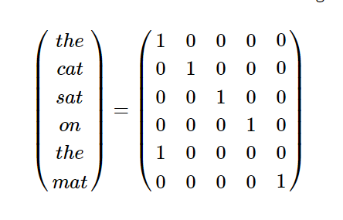
Why do we need Word2vec?
Word2vec:
A deep learning technique that focuses on meaning of words. It tries to understand the meaning and semantic relationship among the words.
Usage:
To reduce one-hot vector to much reduced word embedding that preserves the context and meaning of the original words.
One-Hot method

Slide 3
Introduction
Dataset: 25,000 IMDB movie reviews.
Train Data: 20,000 rows containing id, sentiment, text for each review.
Test Data: 5,000 rows containing id, sentiment and text for each review.
Prediction: Sentiment for each review.
If IMDB rating < 5 then the sentiment score is 0, and rating >=7 sentiment score is 1.
Data Fields:
ID – Unique ID for each review
Sentiment(Binary) – Sentiment for each review, 1 for positive and 0 for negative
Review – Text of the reviews for movies
Models used:
Word2vec based models – CBOW(Continuous Bag of Words)
Classification: Random Forest, Logistic Regression, SVM, KNN

Slide 4
Data Cleaning & Text Preprocessing
BeautifulSoup Package – Removing HTML Markup
Regular Expression – To remove punctuation and numbers
Converting reviews to lowercase and split them into individual words
Stopwords list from NLTK– Removing words like “a”, “the”, “and”, “is”
NLTK porter stemmer – It allows us to treat “message”, “messages”, “messaging” as a single word

Slide 5
Bag of Words Model
Bag of words model
Takes all the words from a sentence and then models them by counting how many times each word appears.
Example:
Sentence 1: “The cat sat on the hat”
Sentence 2: “The dog ate the cat and the hat”
Vocabularies from both the sentences:
[the, cat, sat, on, hat, dog, ate, and]
Feature vector for both the sentences:
Sentence 1: [2,1,1,1,1,0,0,0]
Sentence 2: [3,1,0,0,1,1,1,1]

Slide 6
Modelling

Slide 7
Random Forest
Without cross validation
With 10 cross validation
Accuracy: 0.8266
Accuracy: 0.8166
n = 5000 | Predicted: 0 | Predicted: 1
Actual: 0 | 2025 | 429
Actual: 1 | 438 | 2108
n = 5000 | Predicted: 0 | Predicted: 1
Actual: 0 | 1968 | 486
Actual: 1 | 431 | 2115

Slide 8
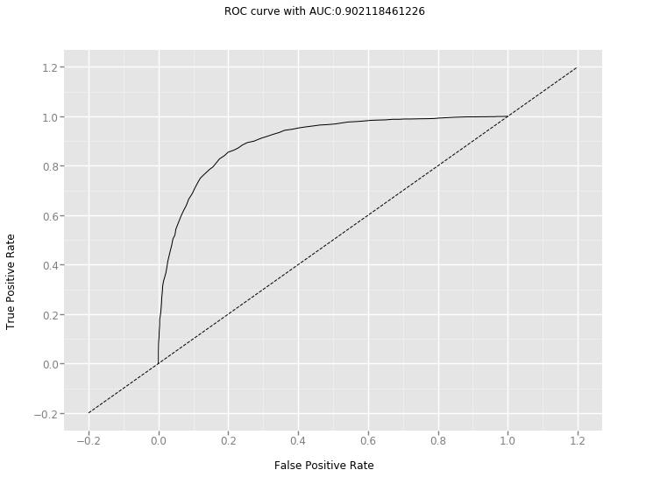
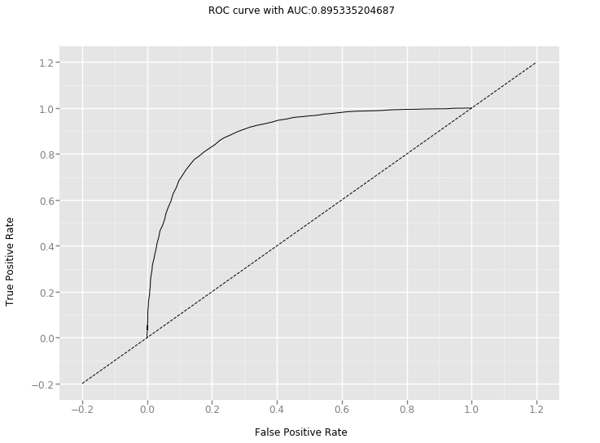
ROC curve
Without cross validation
With 10 cross validation

Slide 9
Logistic Regression
Without cross validation
With 10 cross validation
Accuracy: 0.8554
Accuracy: 0.814
n = 5000 | Predicted: 0 | Predicted: 1
Actual: 0 | 2063 | 391
Actual: 1 | 332 | 2214
n = 5000 | Predicted: 0 | Predicted: 1
Actual: 0 | 1979 | 475
Actual: 1 | 455 | 2091

Slide 10

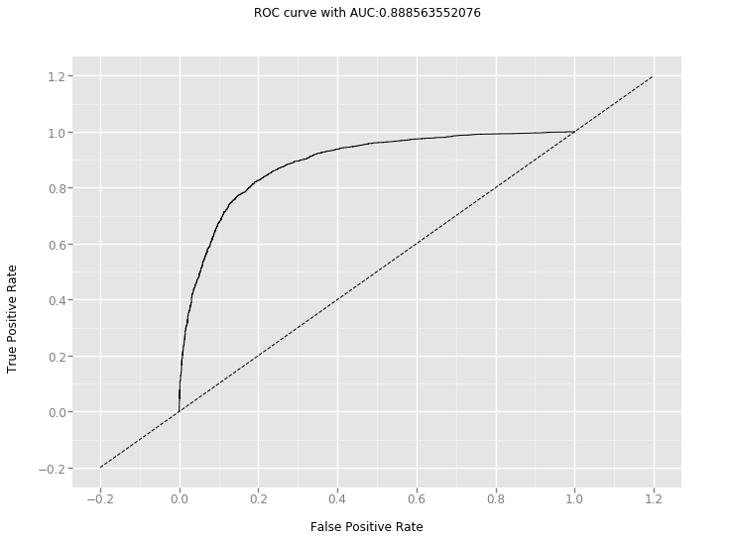
ROC curve
Without cross validation
With 10 cross validation

Slide 11
Support Vector Machine
Without cross validation
With 10 cross validation
Accuracy: 0.851
Accuracy: 0.8036
n = 5000 | Predicted: 0 | Predicted: 1
Actual: 0 | 2052 | 393
Actual: 1 | 352 | 2203
n = 5000 | Predicted: 0 | Predicted: 1
Actual: 0 | 1943 | 502
Actual: 1 | 480 | 2075

Slide 12
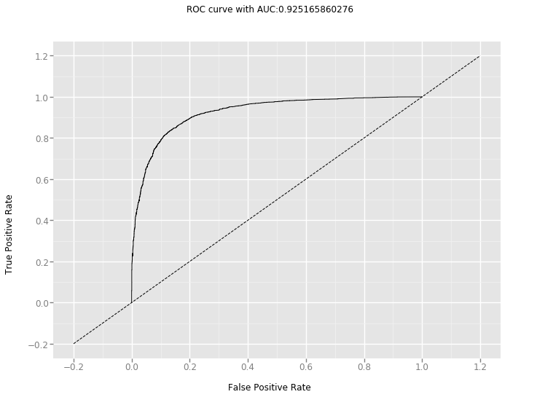
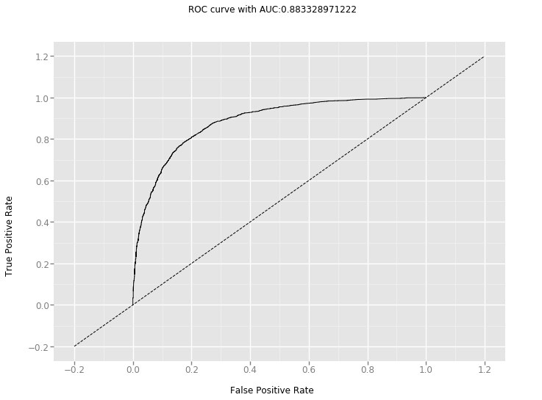
ROC curve
Without cross validation
With 10 cross validation

Slide 13
Conclusion
Model | Without cross validation |  | With cross validation
 | Accuracy | AUC Score | Accuracy | AUC Score
Random Forest | 0.8266 | 0.9021 | 0.8166 | 0.8953
Logistic Regression | 0.8554 | 0.9285 | 0.8140 | 0.8885
SVM | 0.8510 | 0.9251 | 0.8036 | 0.8833

Slide 14
Thank You…

